Slide 1
A Tale of Two Careers (tightly intertwined)
Andrew J. Viterbi
Presidential Chair Professor of Electrical Engineering
University of Southern California
September 25, 2017

Slide 2
Careers’ Timeline
JPL/USC 1957-1963
UCLA 1963-1975
UCSD 1975-1985 Linkabit 1969-1985
UCSD 1985-1994 Qualcomm 1985-2000
------------------------------------------------------------------------------
USC/Technion/UCSD 2000-- Viterbi Group 2000--

Slide 3
External Influences
Andrey Andreyvich Markov (1906)
The Cold War (1948-1989)
Digital (R)Evolution (1948---)

Slide 4
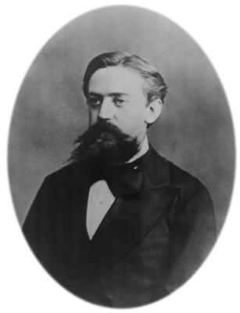
Andrey Andreyevich Markov (1856-1922)
Disciple of P. Chebyshev
Markov Chains (1906)
(AKA Sequences, Processes)
Politically active in 2nd Duma in opposition to Tsar
1913 Organized Celebration of
200th Anniversary of
Law of Large Numbers
As Protest of
300th Anniversary of
Romanov Dynasty

Slide 5
Processes, Sequences and Chains: Three Markov Entities
• Continuous Time, Continuous State Process
• Discrete Time, Continuous State Sequence
• Discrete Time, Discrete State Chain

Slide 6
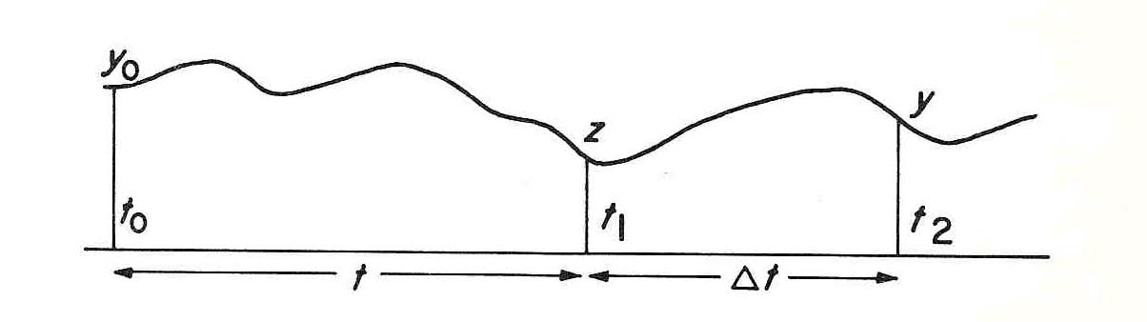
Continuous Markov process
p(y;t₂|z;t ₁,y₀ ;t₀) = p(y;t₂|z;t ₁)

Slide 7
Continuous Time Markov Process Theory
Uhlenbeck, Ornstein: 1930
Kolmogorov 1931
Andronov, Pontryagin, Witt 1933
Wang, Uhlenbeck 1945
Siegert 1951
Darling, Siegert 1953

Slide 8
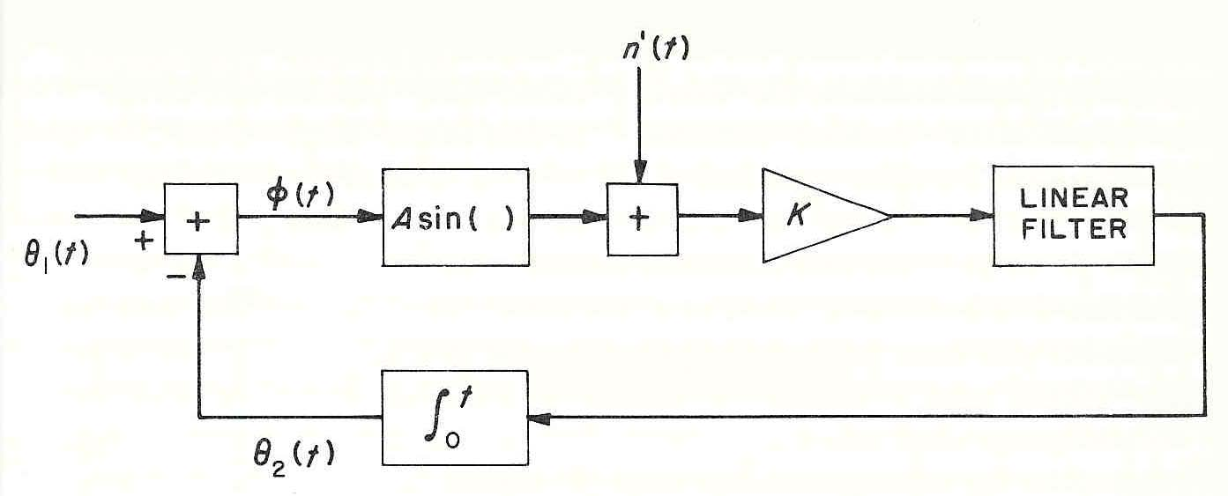
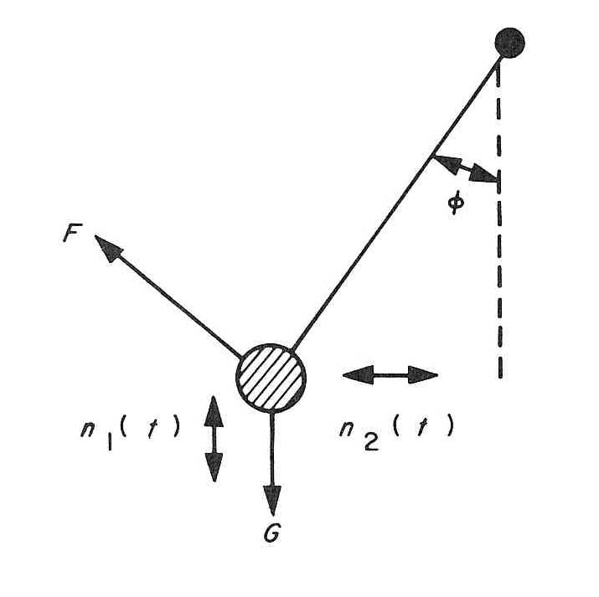

Communication Application: Phase-locked-loop behavior in the presence of noise
1st Order Loop (without Filter):
Mechanical Analog of 1st Order Loop: Pendulum

Slide 9
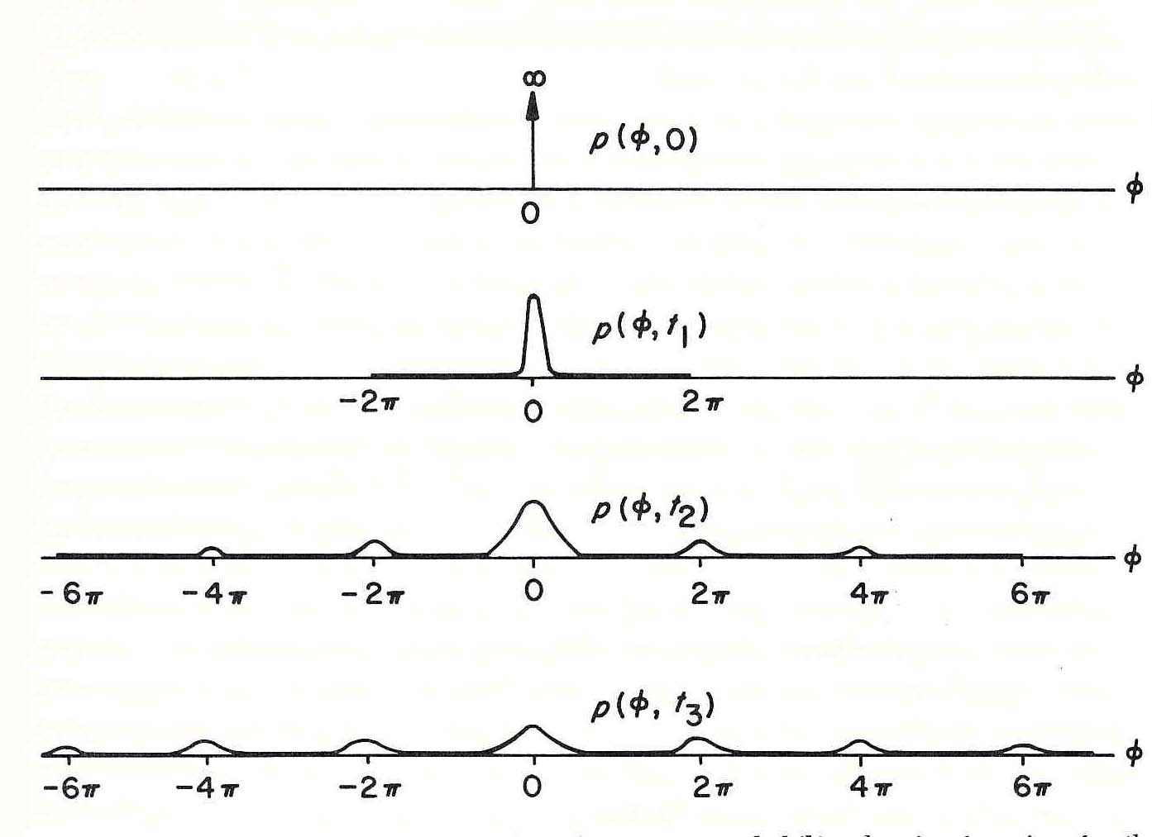
Qualitative behavior of the phase-error probability-density function for the first-order loop
Temporal Evolution

Slide 10


Fokker-Planck Equation for Probability Density-function of Continuous Markov Process
Let

Slide 11
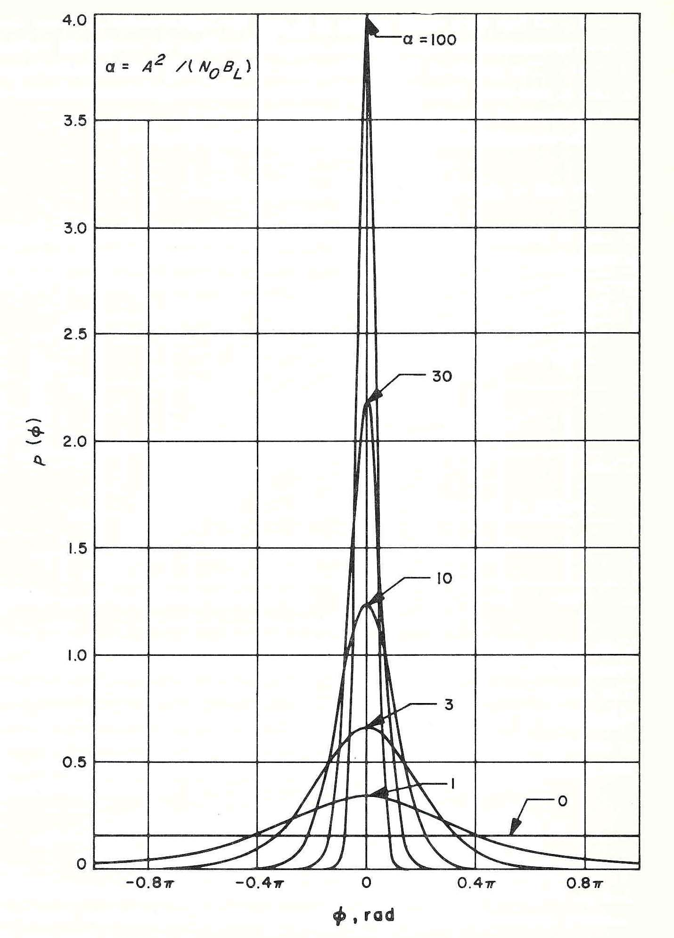


First-order-loop steady-state phase-error probability densities for zero frequency-error
( Tikhonov Distribution, 1960)
Mean Frequency of Skipping Cycles
=Inverse 1st Passage Time:
(Viterbi, 1963)

Slide 12
Discrete Time-Continuous State Sequences Linear Filtering/Estimation
Stochastic Signals in Noise
Gauss Early 1800’s
Wiener 1931, 1942
Bode, Shannon 1950
Kalman (Filter) 1960

Slide 13

Wiener Filtering Model: Stochastic Signal z generated by filtering white noise u observed in presence of additive white noise n
i.i.d. Gaussian
n_{k}
x_{k}
x_{k-1}
z_{k}
y_{k}
u_{k}
a(D)
i.i.d. Gaussian
“white”
b(D)
If a and b are scalars, state x is Markov
x_{k} = u_{k} + b x_{k-1}
y_{k} = ax_{k-1} + n_{k}

Slide 14
General Discrete Linear Filter H(D)=a(D)/b(D)
….…
+
+
z(D)
a₁
a₂
a_{n}
x_{k}
x_{k-1}
x_{k-2}
x_{k-n}
u(D)
………
+
b₁
b₂
b_{n}
+
+
z(D)= H(D) u(D), H(D) = a(D)/b(D)
a(D)= a₁D+a₂D²+a₃D³+………+a_{n}D^{n}
b(D)=1-b₁D –b₂D² …………….- b_{n}D^{n}

Slide 15
Vector Equations
….…
+
+
z(k)
a₁
a₂
a_{n}
x_{k}
x_{k-1}
x_{k-2}
x_{k-n}
………
+
u(k)
b₁
b₂
b_{n}
+
+
……….
x(k) = B x(k-1) + u(k); u(k) = [u_{k} ,0,0….0]^{T}
z(k) = A x(k-1); a = [a₁, a₂,………..a_{n}]

Slide 16
Time-varying Linear Model in Noise
n(k)
x(k+1)
x(k)
z(k)
u(k+1)
y(k)
a(k)
i.i.d. Gaussian
“white”
n(k) is i.i.d. sequence of Gaussian r.v.
B(k+1,k)
Problem:
Find Least Mean Square Error (LMSE)
Estimate x_{k} of x_{k}
(Since Inputs are Gaussian,
LMSE Filter/Estimator is Linear)
ˆ
x(k+1) = B(k+1,k) x(k) + u(k+1)
z(k) = a(k) . x(k)
y(k)=z(k) + n(k)

Slide 17
LMSE Filter (Kalman)
INNOVATION
y(k)
(k)
GAIN
ˆ
ˆ
x(k+1|k)
x(k|k-1)
ˆ
z(k|k-1)
K(k)
A(k)
+
_
B(k,k-1)
ˆ
ˆ
x(k+1|k) = B(k+1|k) x(k|k-1) +K(k) (k)
Gain Equation
K(k) is Function of A, B and MSE(k)
Nonlinear Recursion for MSE(k)
ˆ
(k) = y(k) – z(k|k-1)
ˆ
^
z(k|k-1) = A(k) x(k|k-1)

Slide 18
Applications
While based on Wiener filter theory for extracting stochastic signals from noise, major applications have centered on estimation of motion parameters in navigation and trajectory and orbit determination, particularly since it applies equally for time-varying systems.
Additional benefit is recursion for Mean Square Error
(Riccati equation)

Slide 19
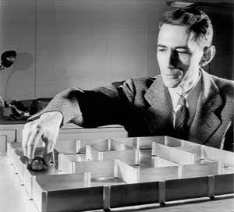
Claude Shannon 1916-2001
B.S., U. of Michigan, 1936
M.S. , MIT, 1937 (thesis: Boolean Algebra for Computer Logic)
Ph.D., MIT, 1940 (Algebra for Theoretical Genetics)
“Mathematical Theory of Communication”, BSTJ 1948
“Mathematical Theory of Cryptography” (memo, 1945)
[later “..of Secrecy Systems”,
BSTJ 1949]

Slide 20
Discrete Time– Discrete (Finite) State Information Theory, Convolutional Codes, Etc.
Shannon, 1948
Elias, 1955
Wozencraft, 1957
Fano, 1963
Viterbi, 1967
Forney, 1972

Slide 21
Intersymbol Interference (ISI) Model
z_{k}
….…
y_{k}
+
+
+
+
a₁
a₂
a_{n-1}
x_{k}
x_{k-1}
x_{k-2}
x_{k-n}
n_{k}
u(k)
………
x(k) = x_{k-n} , x_{k-n+1} ,….. x_{k-1} , x_{k}
y_{k} =a . x(k) + n_{k}
where x_{k} = +1 or -1 with equal probability
x(k) is n-dimensional binary vector with 2^{n} states
n_{k} is Gaussian i.i.d. sequence

Slide 22
4-State Markov Graph Example
m₃₃
S
3
m₁₃
m₁₂
m₃₂
State Metric M₁(k)
S
S
1
m₂₁
2
Branch metric m₀₁
m₂₀
S
0
m₀₀
M_{j}(k)=Max_{i} {M_{i}(k-1) + m_{ij}(k)}
where m_{ij} = -∞ if branch is missing.

Slide 23
Convolutional Channel Code Example
110101
n(k)
x
x
z_{a}
State Diagram
--+-+-…..
-y_{a} +y_{b}
y(k)
+
x(k)
z_{b}
x
- -
+y_{a} -y_{b}
+y_{a} -y_{b}
+ -
-y_{a}+y_{b}
- +
General Decoding Algorithm:
M_{j} (k+1) = Max_{i} [M_{i} (k) +m_{ij}(k)]
+y_{a} +y_{b}
Branch Metric
-y_{a} -y_{b}
-y_{a} -y_{b}
++
States: M_{j}
( m_{ij} = - if branch ij is missing)
+y_{a} +y_{b}
Applies for arbitrary generators even time-varying

Slide 24
Some Markov Comparisons
Processes (Continuous Time and State):
Partial differential equation describes evolution of pdf even for nonlinearities, but exact solution only for 1st order systems.
Sequences (Discrete Time, Continuous State):
Least Mean Square Error Linear Estimator (even for time-varying)—
Optimum for Gaussian i.i.d. inputs and additive noise
Chains (Discrete Time, Discrete (Finite) State):
Maximum Likelihood Estimator for arbitrary nonlinear and time-varying systems but independent inputs and noise

Slide 25
Applications and Extensions
Hidden Markov Model Examples
Speech Recognition
Data Recording
Search Engines
Genome Sequence Alignment
Machine Learning

Slide 26
Entrepreneurial Career in Telecommunications
JPL: the Cold War and Space
Linkabit Corporation: DoD and NASA
Qualcomm, Inc.: Commercial and Consumer
All Exploiting Spread Spectrum

Slide 27
Spread Spectrum Purposes
Interference Suppression
Energy Density Reduction
Ranging—Time Delay Measurement

Slide 28
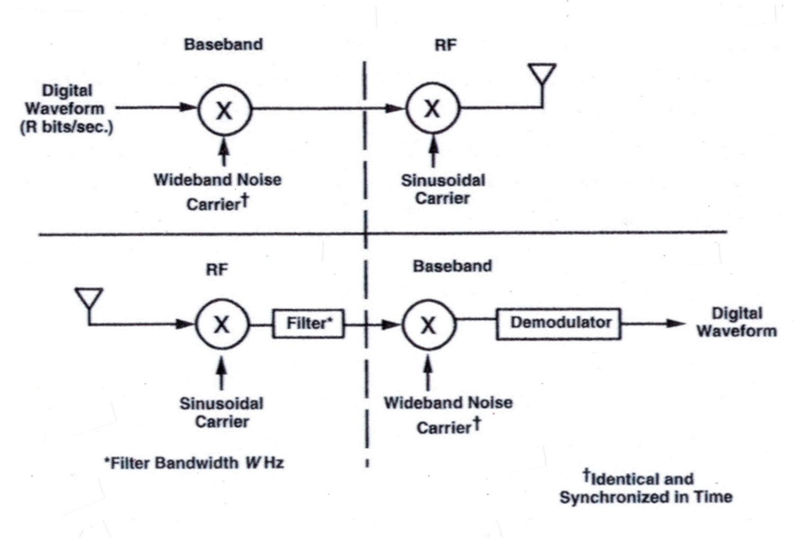
Spread Spectrum Modem

Slide 29
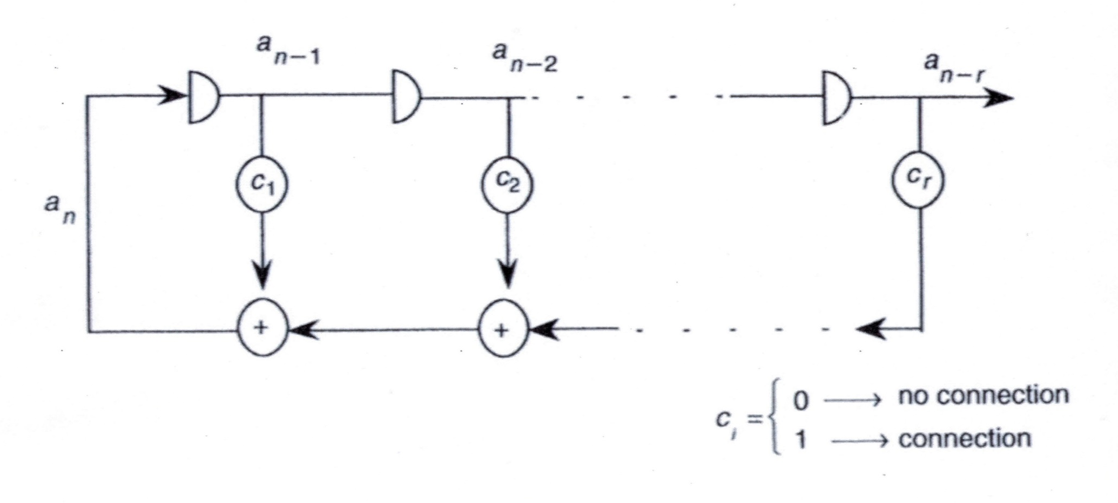
Linear Shift Register Sequence Generator
(wideband noise generator)

Slide 30
Pseudorandom Sequence Generation
By proper selection of the tap values (0 or 1), the generated sequence will be a Maximal Length Shift Register Sequence;
As a consequence it will have 3 Randomness Properties
thus imitating Bernoulli (coin flipping) sequence [Golomb,1967]:
R1: Balanced (nearly)—equal number 0’s and 1’s
R2: Run Length Frequencies
R3: Delay and Add– near zero auto-correlation (i.i.d.)

Slide 31
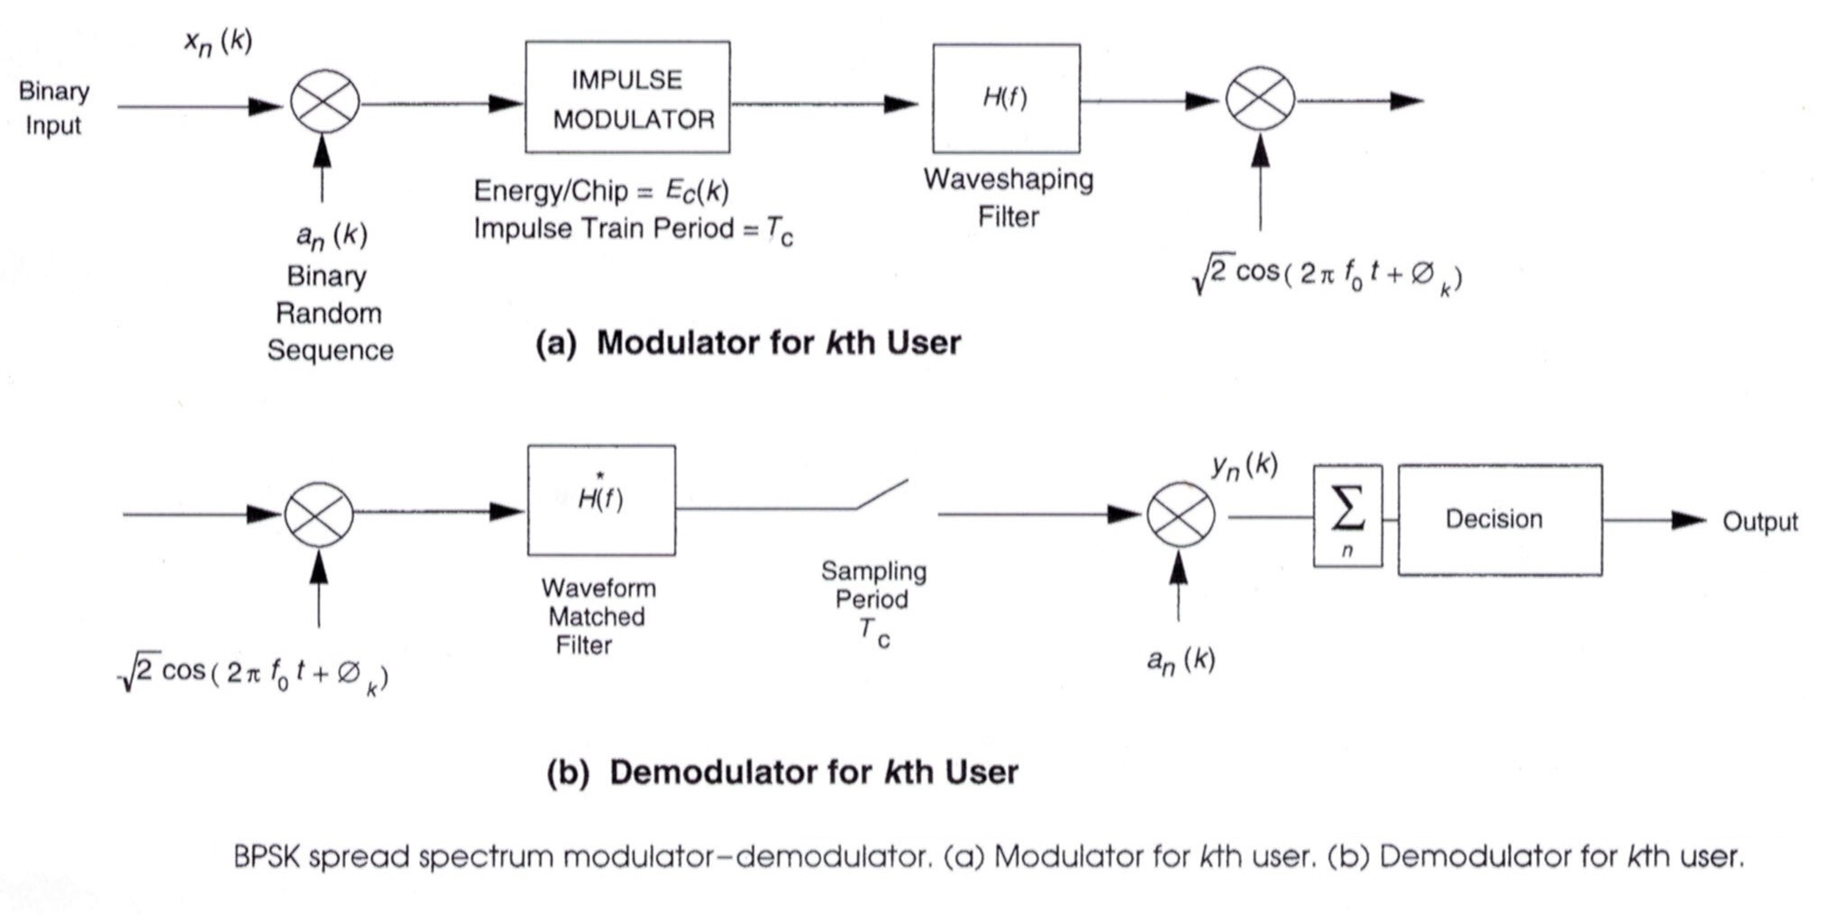
BPSK Spread Spectrum Modulator-Demodulator

Slide 32
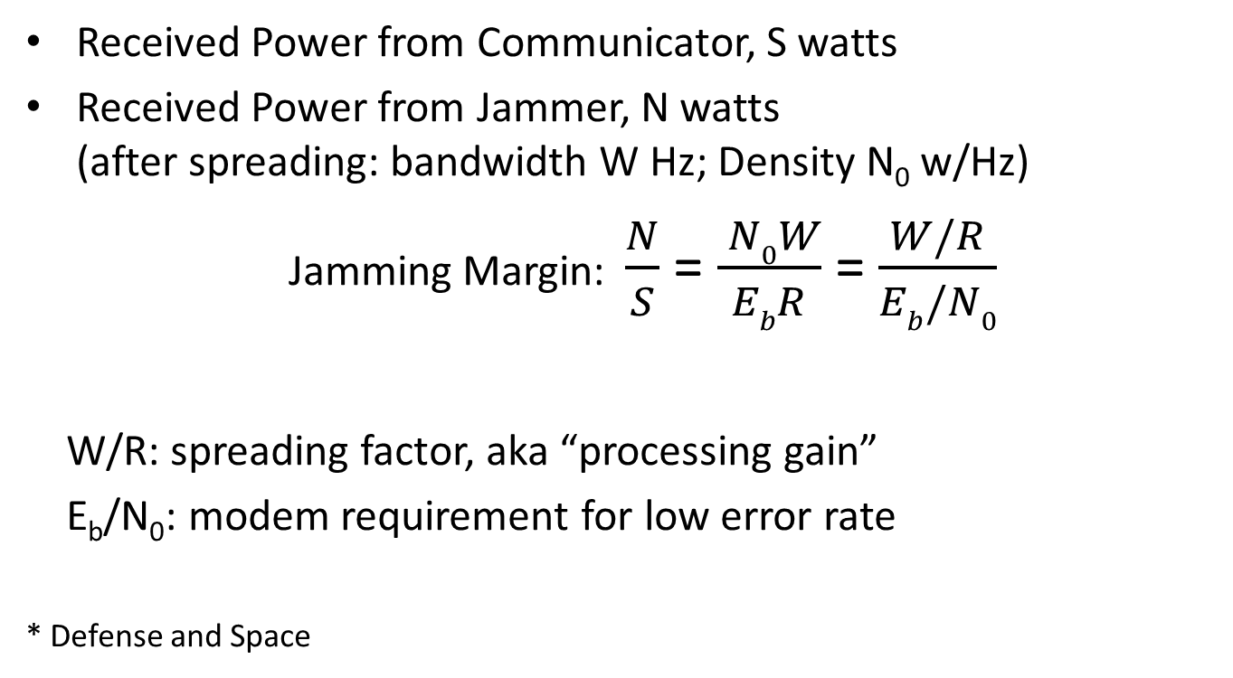
Jamming Margin*
Received Power from Communicator, S watts
Received Power from Jammer, N watts (after spreading: bandwidth W Hz; Density N₀ w/Hz)
Jamming Margin: $\frac{N}{S}$ = $\frac{ N0W}{EbR}$ = $\frac{W/R}{Eb/N0}$
W/R: spreading factor, aka “processing gain”
E_{b}/N₀: modem requirement for low error rate
* Defense and Space

Slide 33
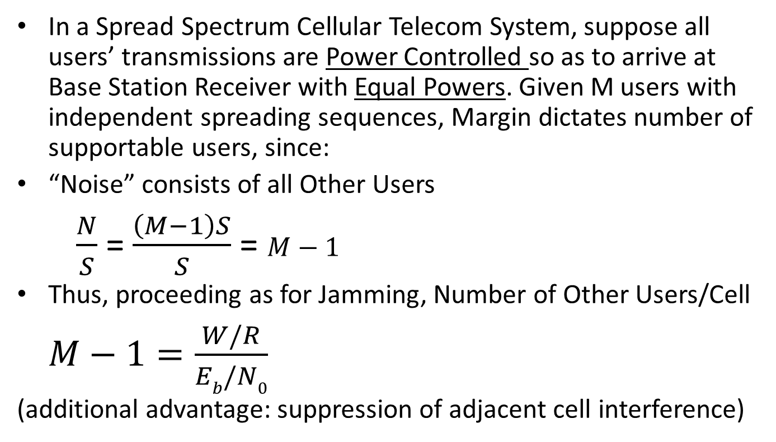
Code Division Multiple Access (CDMA)*
In a Spread Spectrum Cellular Telecom System, suppose all users’ transmissions are Power Controlled so as to arrive at Base Station Receiver with Equal Powers. Given M users with independent spreading sequences, Margin dictates number of supportable users, since:
“Noise” consists of all Other Users
$\frac{N}{S}$ = $\frac{\left(M−1\right)S}{S}$ = $M−1$
Thus, proceeding as for Jamming, Number of Other Users/Cell
$M−1=\frac{W/R}{Eb/N0}$
(additional advantage: suppression of adjacent cell interference)
*Commercial and Consumer

Slide 34
That’s It
Six Decades of Fun

