Slide 1
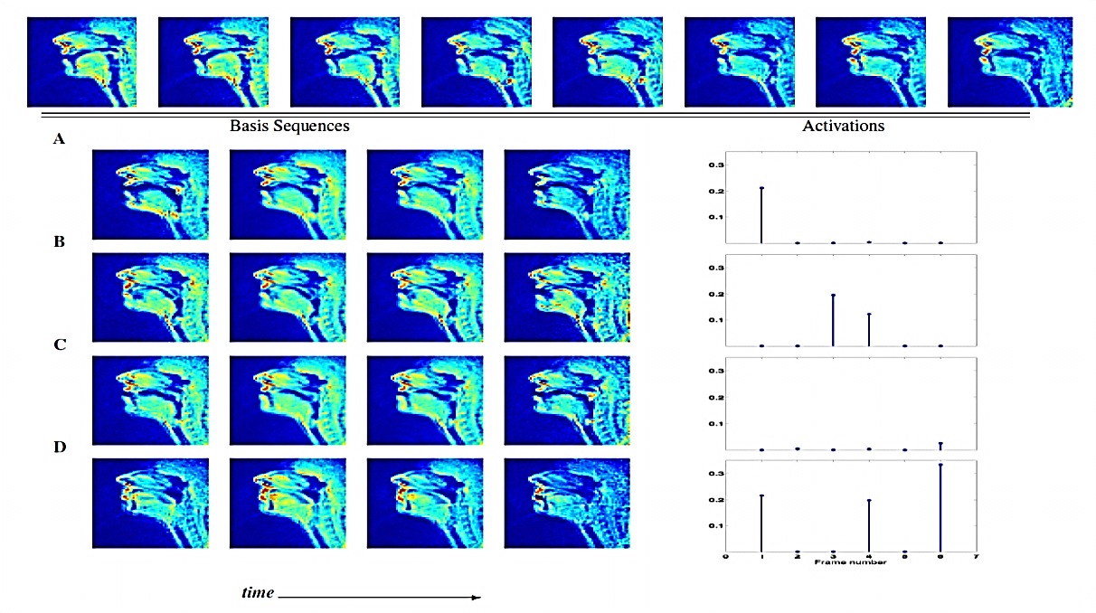
SPARSITY & SPEECH SCIENCE? TOWARDS A DATA-DRIVEN CHARACTERIZATION OF SPEECH MOTOR CONTROL
VIKRAM RAMANARAYANAN
University of Southern California, Los Angeles

Slide 2
SPEECH PRODUCTION INVOLVES COMPLEX COORDINATION!
WHY STUDY THIS?
Scientific understanding
Clinical rehabilitation
LIPS
Understanding languages
Robotics/prosthetics
THROAT
How do we model speech motor control?
S. Narayanan et al (2004), JASA.

Slide 3
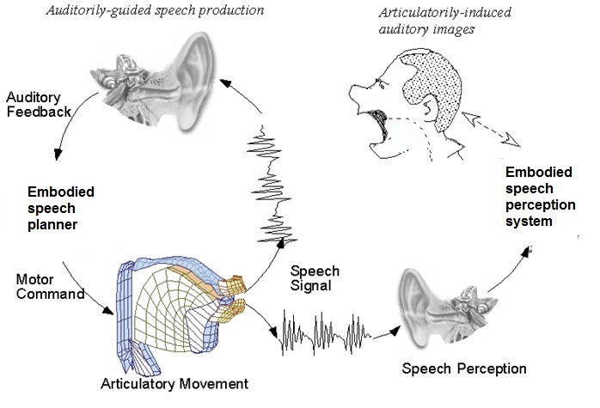
THE SPEECH COMMUNICATION CHAIN
The speech communication system is complex!
Image adapted from: Jianwu Dang, http://www.jaist.ac.jp
GOAL: Build a systems-level model of the speech motor controller.

Slide 4
CONCEPTUAL OUTLINE OF MY WORK
CONTROLLER
Hypotheses: kinematic & postural planning – pauses
Build better control models
Use results : insight into motor control models
Movement primitives:
low-dim. space for control and coordination
BEHAVIOR
TOP-DOWN
BOTTOM-UP

Slide 5
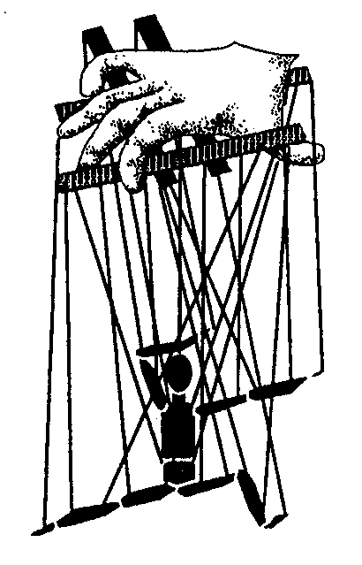
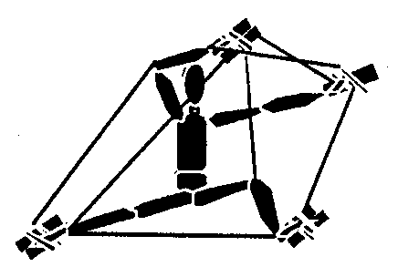
ATTACKING THE COORDINATION PROBLEM
Coordination: bringing of parts into proper relation.
Problem: Too many degrees of freedom!
One perspective: Each degree-of-freedom behaves in a well defined way as defined by a central controller
Bernstein (1967). Coordination and regulation of movements.
Bernstein’s suggestion: The system self-organizes its multiple degrees of freedom to work in only a few principal dimensions
Notes:
Cite turvey reference (coordination) and marieke rohde ppt

Slide 6
ARTICULATORY PRIMITIVES
A set of time-varying functional units (“synergies”) or basis functions, weighted combinations of which can be used to represent any movement of articulators in the vocal tract.
OPTIMIZATION GOAL:
Find a spatiotemporal dictionary of primitives that trades off :
RECONSTRUCTIO N ACCURACY
MODEL-DEPENDENT SMOOTHNESS OR SPARSITY
We designed an algorithm that solves this optimization problem
V. Ramanarayanan et al, JASA, under review.
Notes:
Articulatory primitives – what are they and why are they important?
Mention INTERPRETABILITY…
Why sparsity?
d’Avella and Bizzi (2002, 05) – Extracting muscle synergies from EMG data.
Hromadka et al. (2008) – Sparse representations of sounds in the auditory cortex.
Olshausen and Field (2004) – Sparse representations in biological vision
Why non-negativity? (Eliminates things like PCA…)
Importance of part-based (additive) representations

Slide 7
EXAMPLE: /kʌt/ as in “CUT”
Release of /k/
Vowel
Formation of /t/
Captures linguistically meaningful events
Notes:
K=15, Sh=0.75, T=4.

Slide 8
ONGOING: FINDING SYNERGIES OF CONTROL INPUTS THAT DRIVE THIS DYNAMICAL SYSTEM
Chhabra and Jacobs (2006). Neural Computation
OPTIMIZATION GOAL:
Find a dictionary of control signals u(t) that trades off :
Goal: To find the optimal control signals u(t) that minimize cost J
ACCURACY OF MOVEMENT TRAJECTORY
VERY LARGE CONTROL VALUES
SMOOTHNESS
Problem: Computationally intractable for nonlinear systems
Solution: Use approx. methods, find locally optimal solns
Li and Todorov (2005). Iterative LQR/LQG methods

Slide 9
CONTRIBUTIONS/FINDINGS
1. An algorithmic framework that can learn interpretable spatio-temporal dictionaries of movement primitives from input timeseries data.
CONTROLLER
STRUCTURE
(VOCAL APPARATUS)
BEHAVIOR
2. A control framework that is based on a small dictionary of control signals, i.e., a lower dimensional control manifold.

Slide 10
OUTLOOK: DIVERSE EE PERSPECTIVES
SIGNAL PROCESSING perspective – Better machine learning:
How can we define better models that capture an optimal number of primitives of variable temporal lengths?
CONTROL perspective – Low-dimensional control manifold:
Can we find synergies of control inputs that can drive this stochastic nonlinear dynamical system?
COMMUNICATION perspective – Production-perception links:
Do we produce speech movements (and thus, primitives) for optimal perception of sounds?
ACKNOWLEDGEMENTS: SAIL and SPAN groups, USC and NIH Grant DC007124.
<vramanar@usc.edu>

