Slide 1
A Computational Study of Expressive Facial Dynamics in Children with Autism
Zhaojun Yang
Noverber 18th, 2016

Slide 2
Atypicality in Autism
Prevalence of Autism
1/68 in US, 1% prevalence in Asia, Europe, 2.6% in South Korea
Children with high-functioning autism (HFA)
Preserve IQ, language and cognitive skills
Have significantly impaired social communication abilities
Facial expressions of children with HFA
Perceived as atypical, awkward or less engaging
Our goal: computationally understand and quantify atypicality of facial dynamics in autism
T. Guha, Z. Yang, R. Grossman and S. Narayanan, “A Computational Study of Expressive Facial Dynamics in Children with Autism”, IEEE Transactions on Affective Computing, 2016
Notes:
We break through the common sense. Even pure water can be conductive.

Slide 3
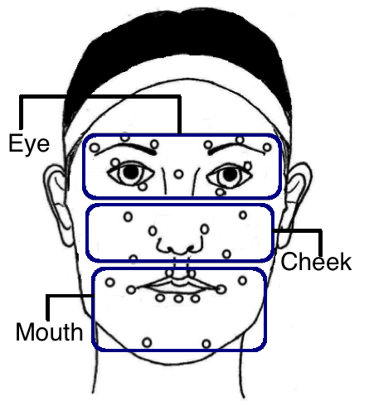
Data Collection
Participants
20 HFA, 19 typically developing (TD)
Modality
Motion Capture Data: 32 facial markers
Expressions
anger, disgust, fear, joy, sadness, surprise
Figure: Marker positions
Notes:
We break through the common sense. Even pure water can be conductive.

Slide 4
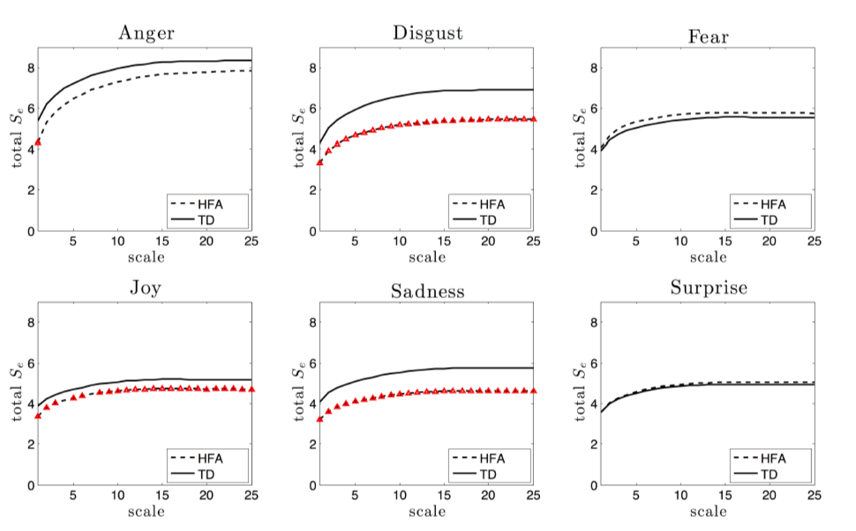
Complexity of Overall Facial Dynamics
Complexity measure: Multiscale Sample Entropy (MSE) [Costa et al.’11]
Significantly reduced complexity in HFA:
Disgust
Joy
Sadness
Notes:
We break through the common sense. Even pure water can be conductive.

Slide 5
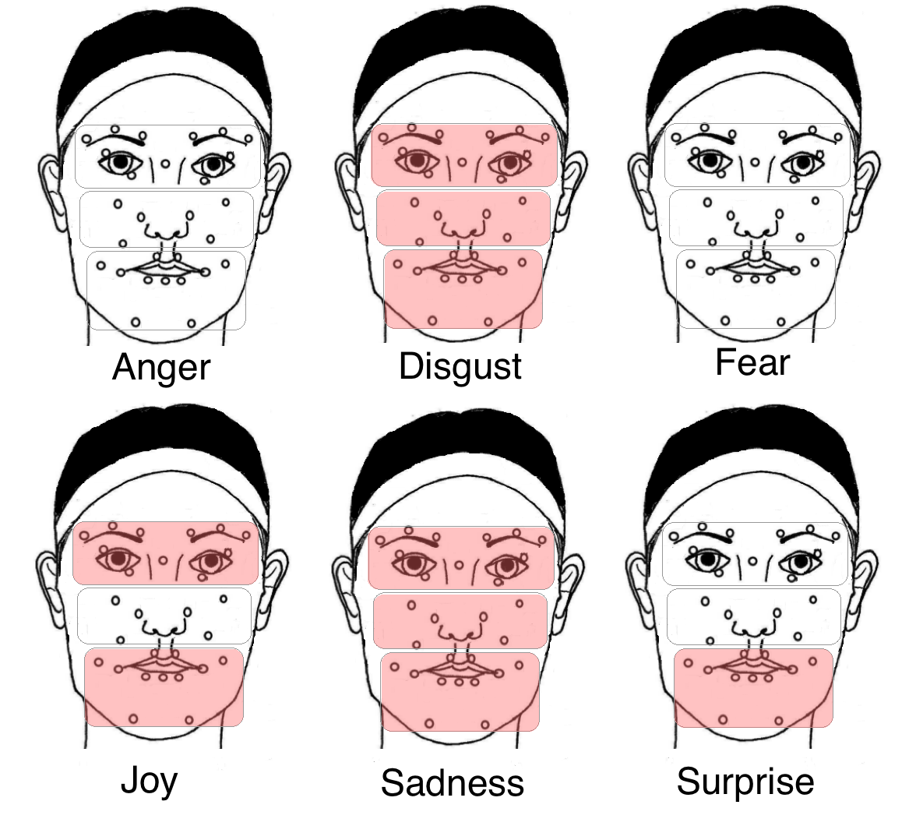
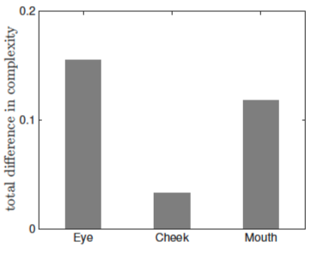
Localized Facial Dynamics
Overall group difference across all expressions
Shaded regions → reduced complexity in HFA (p<0.05)
Notes:
We break through the common sense. Even pure water can be conductive.

Slide 6
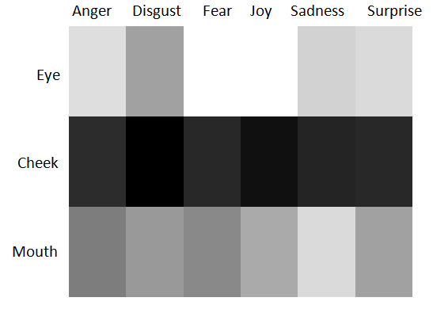
Localized Facial Dynamics
HFA-TD dissimilarity of dynamical patterns
Brighter color indicate larger group difference
Eye region shows highest HFA-TD dissimilarity. followed by mouth and cheek regions.
Notes:
We break through the common sense. Even pure water can be conductive.

Slide 7
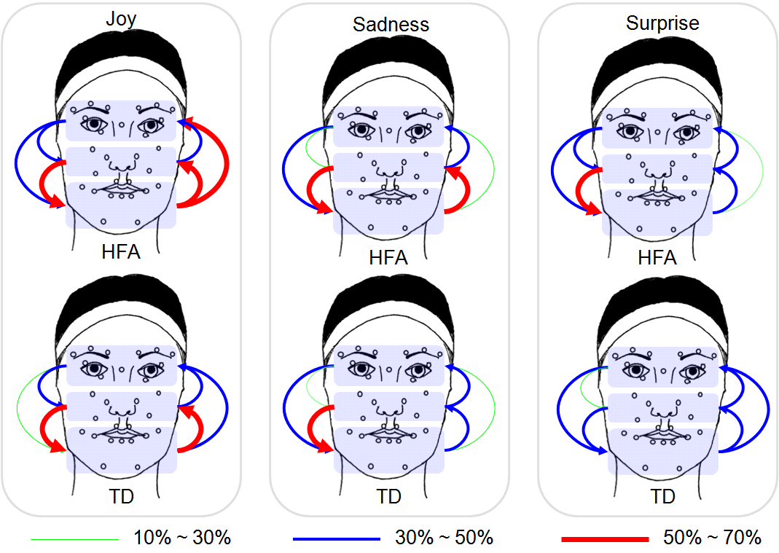
Covariation dynamics between facial regions
Granger causality dependency
Stronger cross-region causal dependency in HFA subjects
The thickness and color of the arrows represent the percentage of subjects showing statistically significant causality (p ≤ 0.05) for the corresponding region pairs.
Notes:
We break through the common sense. Even pure water can be conductive.

Slide 8
Summary
Reduced complexity in facial dynamics in HFA group
Higher predictability in motion patterns in HFA group
Major HFA-TD dissimilarity in the eye region
Thanks!
Notes:
We break through the common sense. Even pure water can be conductive.

